Slide 1
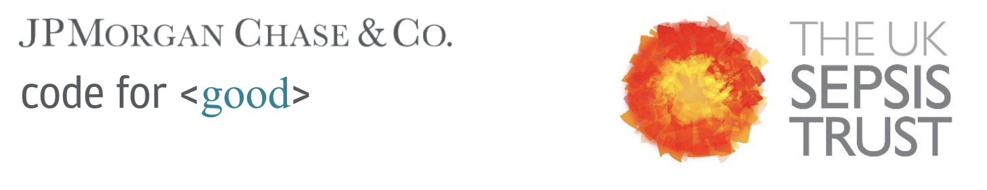
Code for Good: Scaling up Support for People Affected by Sepsis
Team 10

Slide 2

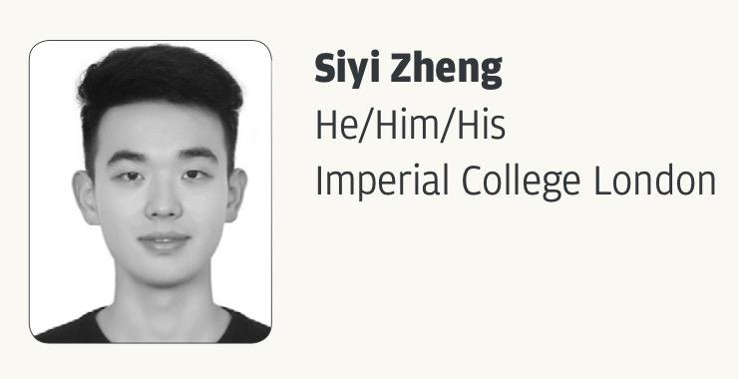
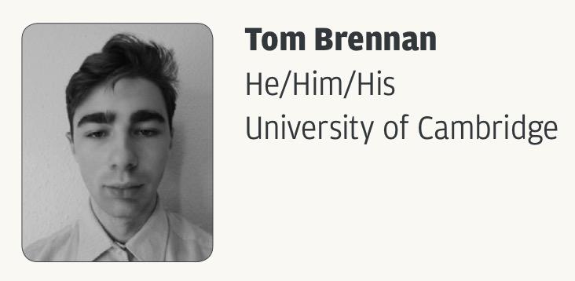
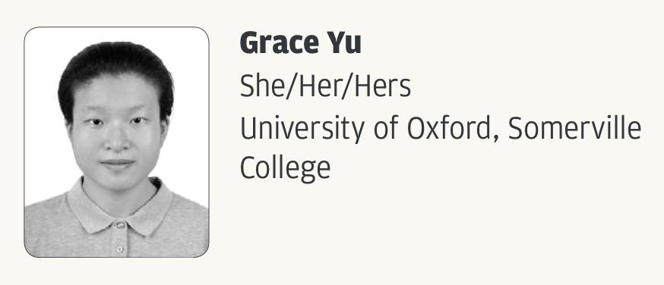
Meet the Team

Slide 3
Challenge Statement - Aims
Scale up support for people affected by sepsis with technology, despite limitations on the number of support nurses at the UK Sepsis Trust
Improve accessibility for different demographics
Collect structured data to advance research on sepsis diagnosis, treatment, and recovery
Notes:
Brush past quickly

Slide 4
Our Solution
In this presentation, we will:
Showcase our vision of a social network
Forum - supportive community to share your experiences and learn about others!
Chatbox - talk to health professionals and AI
Wellbeing Diary - document your recovery!
Discuss future areas of development & research
Support Different Languages - with the help of Generative AI!
Raise Awareness through Social Media
Share Information about sepsis, developed by our volunteers in an engaging format
Keep Traditional Communications Alive - Posters, Talks
Notes:
GRACE

Slide 5
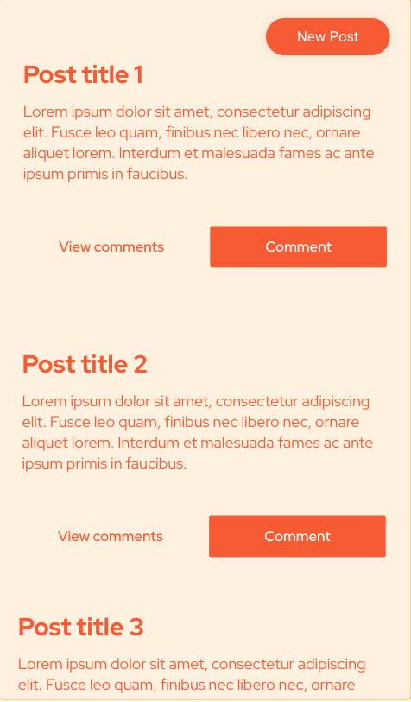
The Forum
Users can log in, or access the forum anonymously as a guest.
Users can make posts, comment on posts, view previous.
Verified nurses and other health professionals can leave medical advice.
Notes:
BELLA
Guest access: allows people who can’t / don’t want to make an account, easily access the information
We wanted to address the problem of low attendance at support groups as well as upscaling support for everyone.
This forum creates a support and information system that’s accessible from anywhere at all times, without putting any pressure on anyone.
Simple interface so can be used by people of all ages and levels of digital literacy

Slide 6
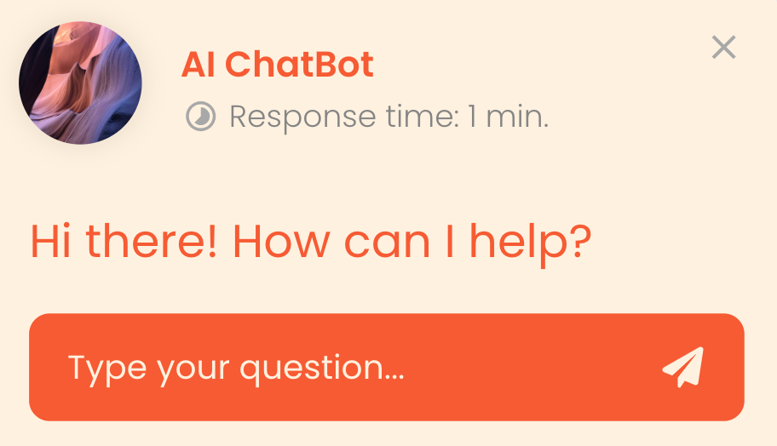
Chat box
Send messages directly to a nurse
Speak with an AI chatbot
Ask guidance on using the platform
Retrieve information quickly
Be cautious about using as a consultant for safeguarding concerns
Notes:
SIYI
Improve accessibility of different demographics
This chatbox tackle accessibility issues, it could help older people get guidance
Help mentally stress patience to retrieve information easily

Slide 7
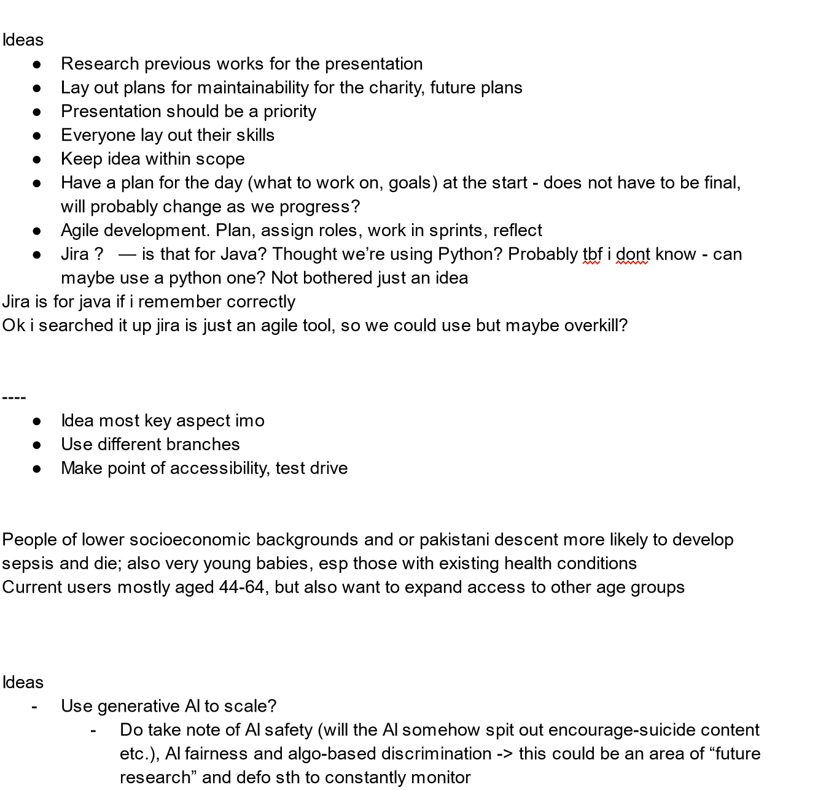
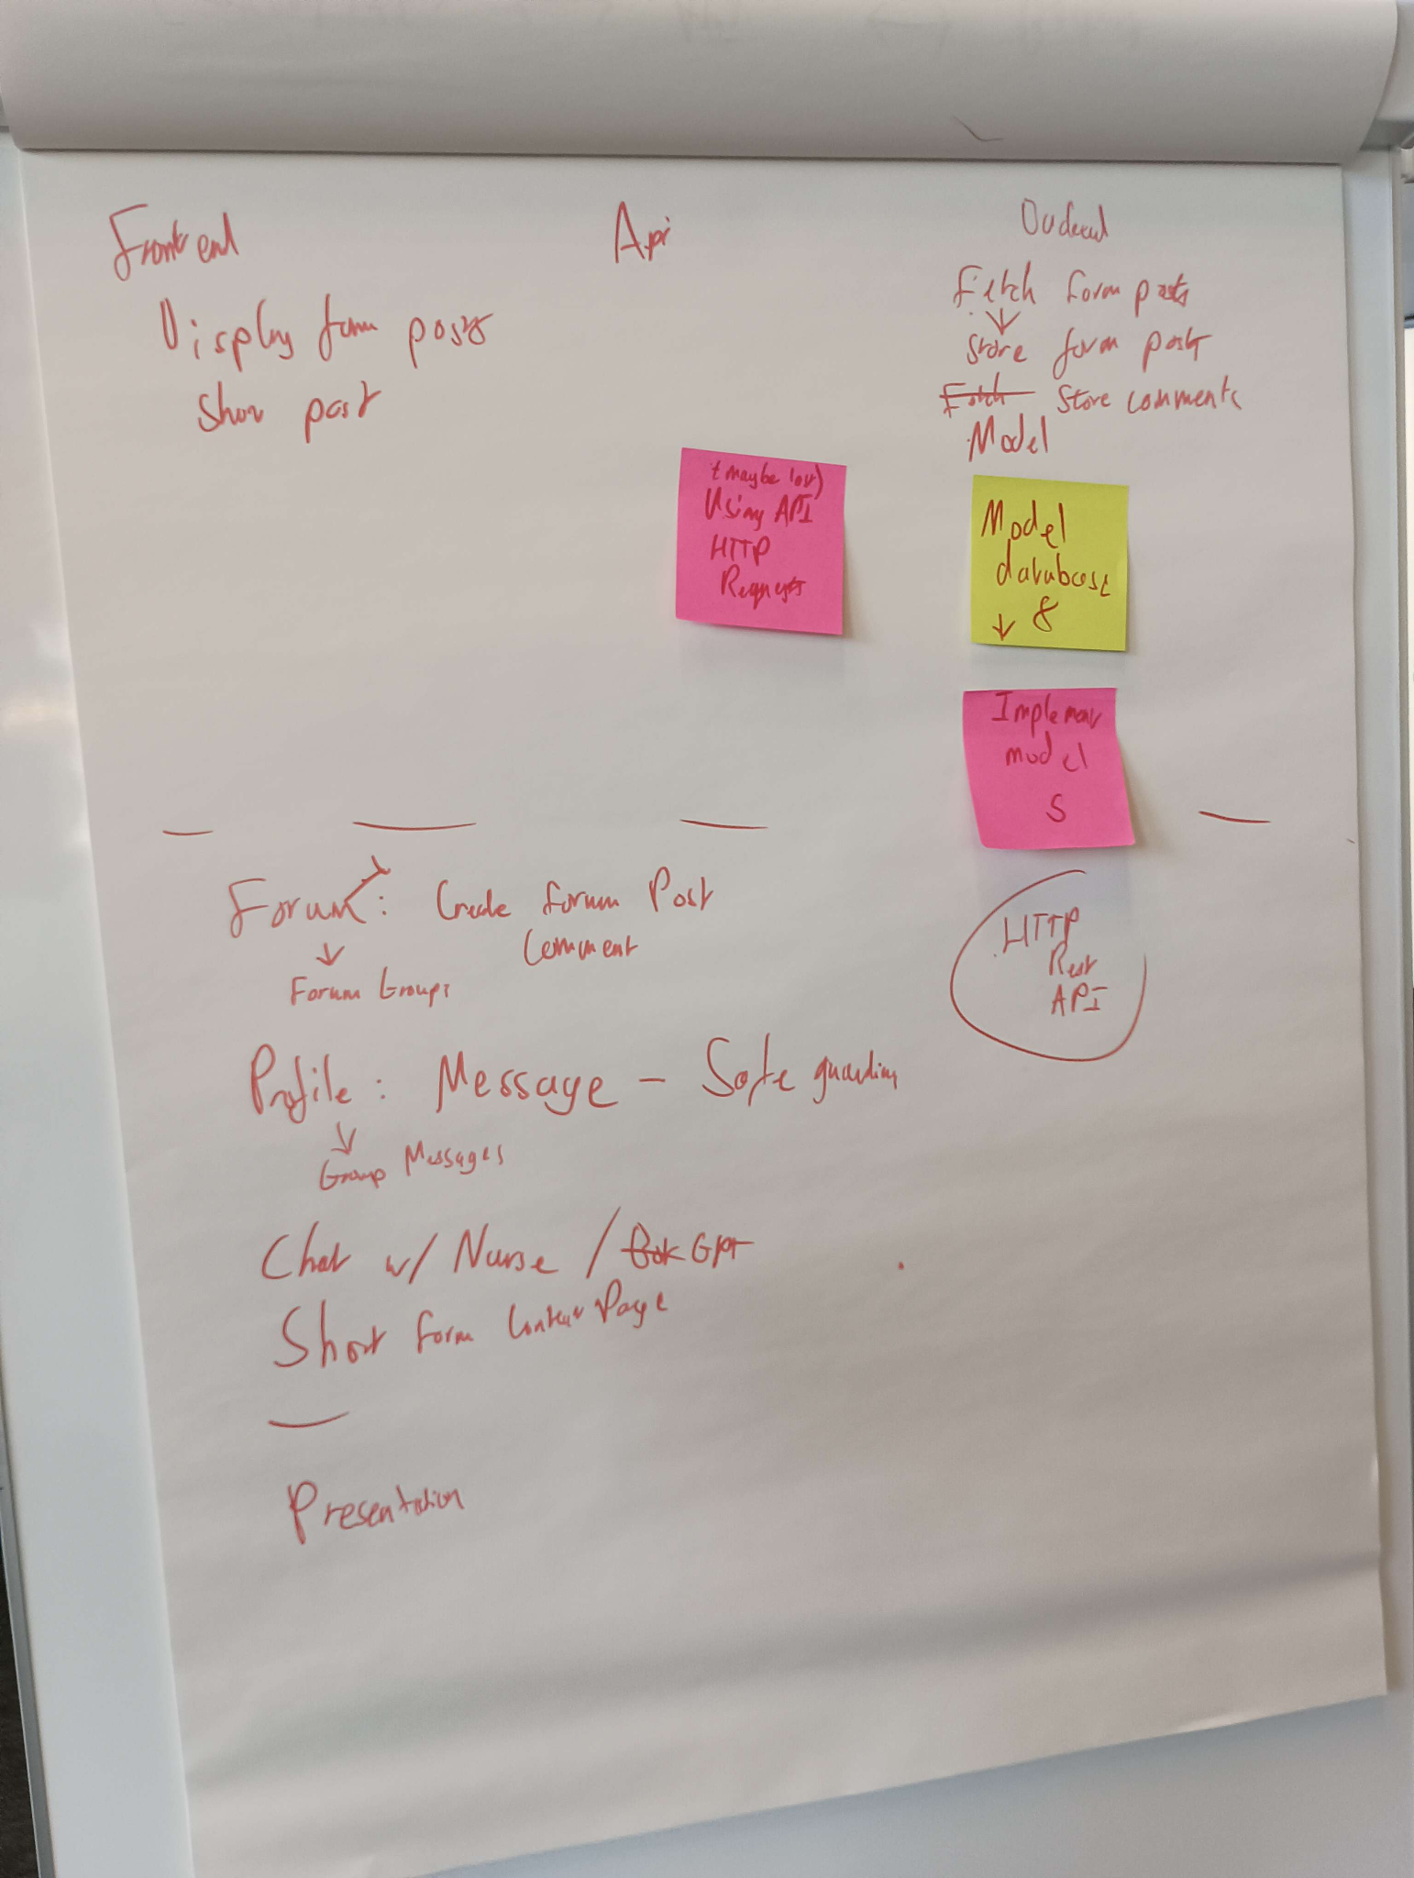
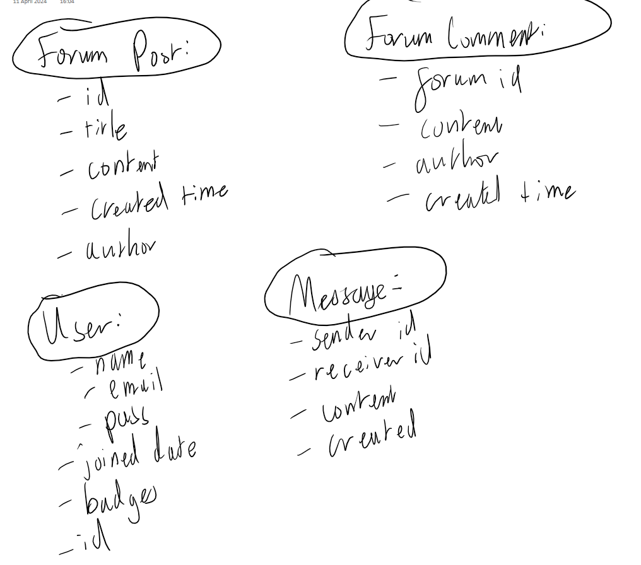
Demo and Creation Process
Notes:
For our development process, we used a agile/ scrum inspired model to assign work, we wrote code that planned for failure to avoid losing users in case of server issues. Our chat can be currently be used to talk with chatgpt, with the idea of also being able to connect them to volunteers and nurses. The chatbot code is nicely encapsulated allowing future programs to swap out the large language model we choose to use, why would you want to do that? Gemini, for instance, has a new model that has a context window of up to one million token, and is good at needle in a haystack searches. To stop spouting what might sound like rubbish, it means you could feed it all of the information stored currently on your websites, and allow users to easily access it through a conversation, vastly improving accessibility and bringing a bit of life to the key information stored on the website.

Slide 8
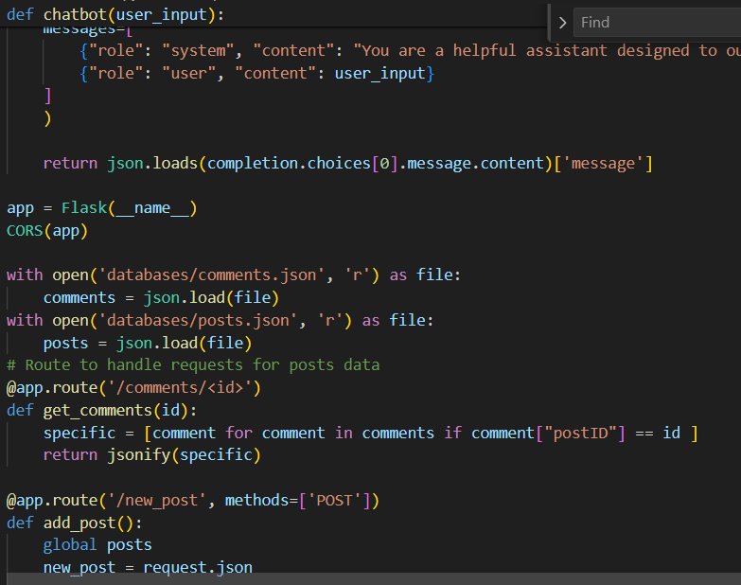
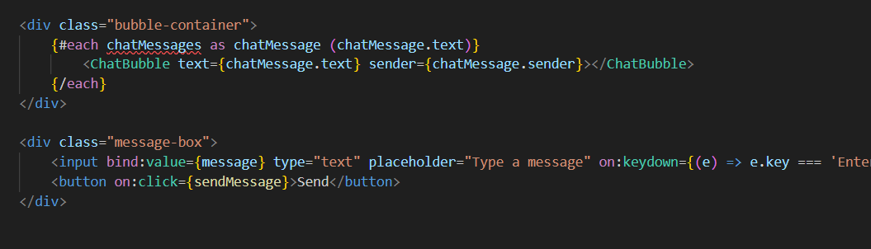
Code

Slide 9
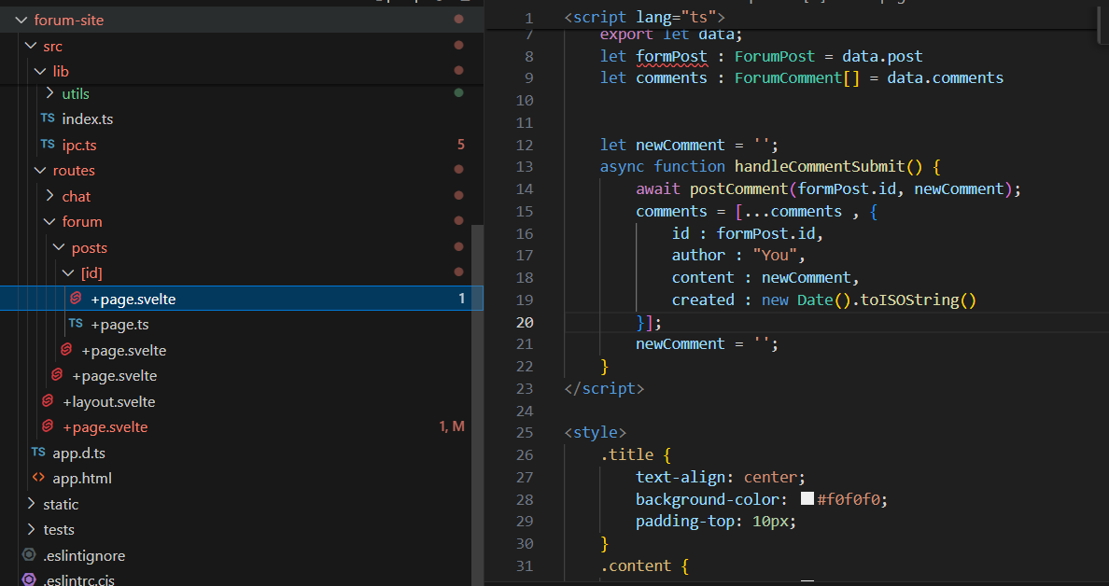
Code

Slide 10
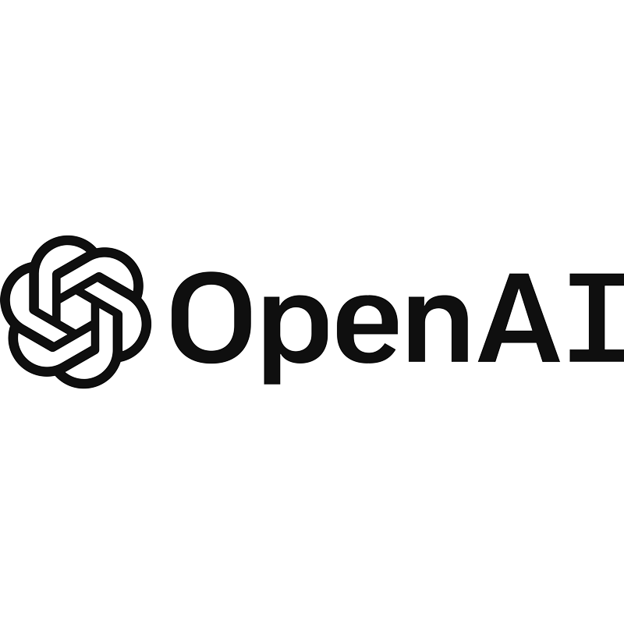


Tech Stack
Frontend
Backend
API
Svelte Kit
Flask
OpenAI API
Notes:
TOM

Slide 11
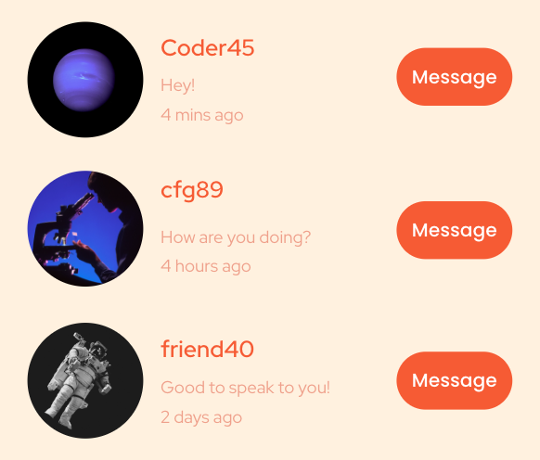

Connect for Support
Allow users to follow each other and message each other.
Profile pictures and bios as an introduction.
Forum groups based on:
Location: Town, city, country, hospital…
Experience: Post sepsis syndrome sufferer, amputees, bereaved…
Nationality: Ethnic background, country of origin…
Forum groups can be favorited and added to sidebar.
Notes:
BELLA
Adding further to the online support system, this functionality allows users to connect with others who are in a similar situation to them, and also are of a similar background to them.
The aim of this is to help people feel like they aren’t alone, and to be able to find, speak with, and meet with people outside of a support group setting.

Slide 12
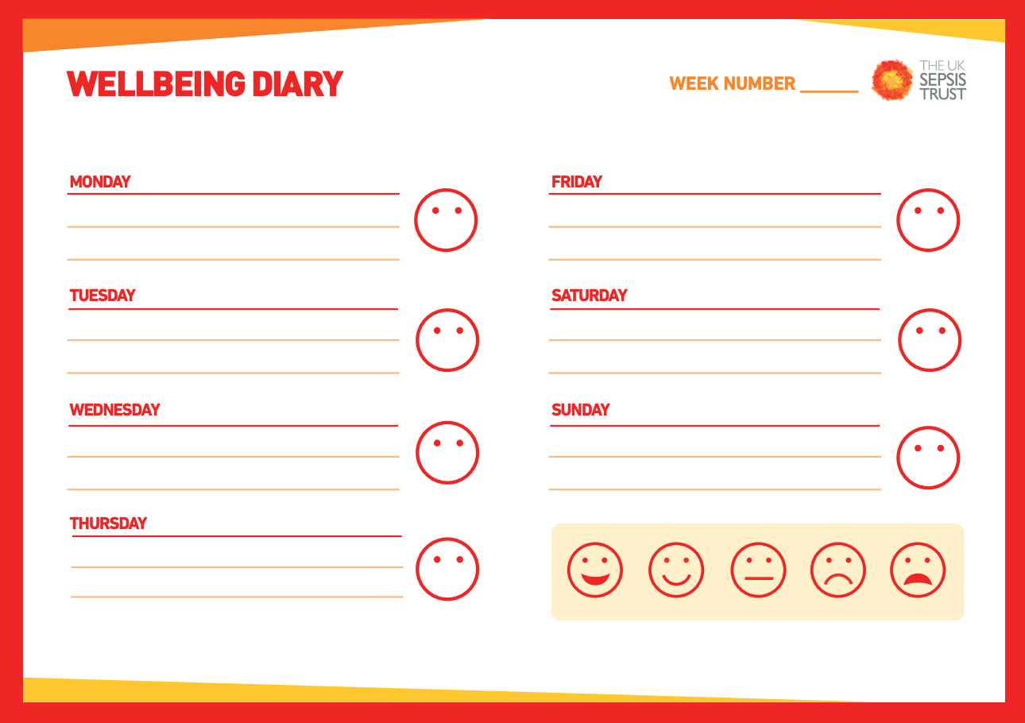
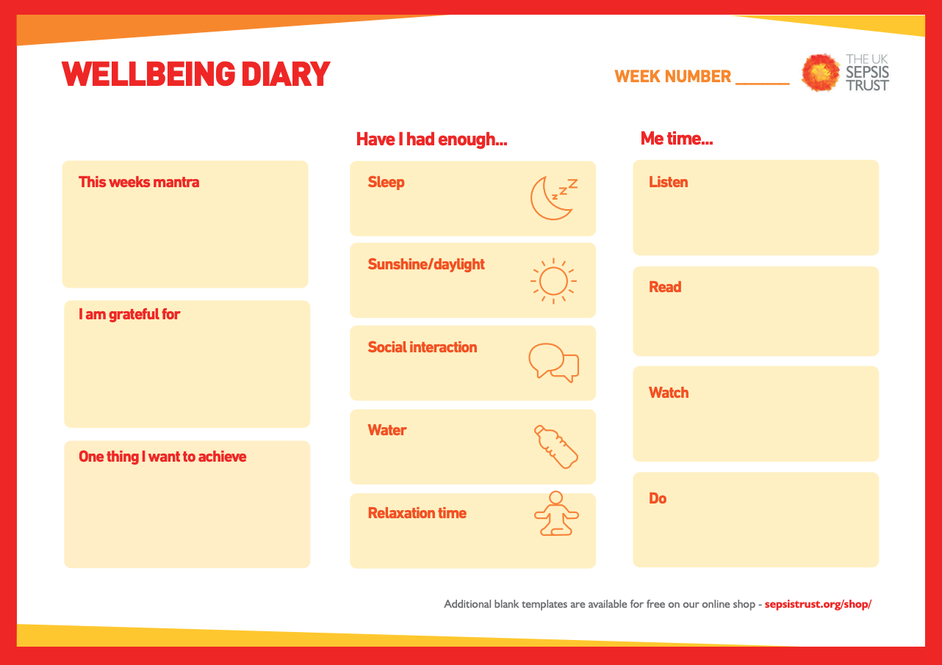
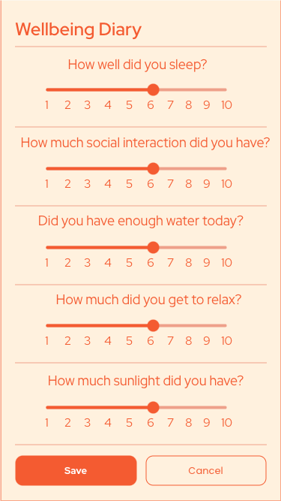
Virtual Wellbeing Diary
Simplify and digitise the wellbeing diary
Collect more structured data to help to understand patient’s recovery process
Encourage users of all ages to take part
Simple app interface
Can assist research, as well as flag and identify vulnerable people based on their inputs
Notes:
SIYI
We’ve also envision implementing a virtual wellbeing diary which is a simplified and digitised version of the wellbeing diary pdf
This could help with collecting more structured data to help to understand patient’s recovery process
It also encourage users of all ages to take part
We adopted a simple app interface with a scale bar from 1 to 10 to tackle accessibility issues
As we are aware people

Slide 13
Future Areas of Development & Research
Support Different Languages - with the help of Generative AI!
Raising Awareness through Social Media
Collaborate with celebrities who have experienced sepsis
Traditional Communications - Posters, Talks
Notes:
GRACE

Slide 14

Expanding Support for Different Languages
Recent development in AI significantly improves machine translation quality
Source: https://www.lionbridge.com/blog/translation-localization/machine-translation-a-generative-ai-model-outperformed-a-neural-machine-translation-engine/

Slide 15
We can translate…
*Forum
Information about sepsis
*Chatbox
*Chatbot
Wellbeing Diary

Slide 16
Future Areas of Development & Research
Support Different Languages - with the help of Generative AI!
Raise Awareness through Social Media
Celebrities who have experienced sepsis can reach many people by making posts
Keep Traditional Communications Alive - Posters, Talks

Slide 17
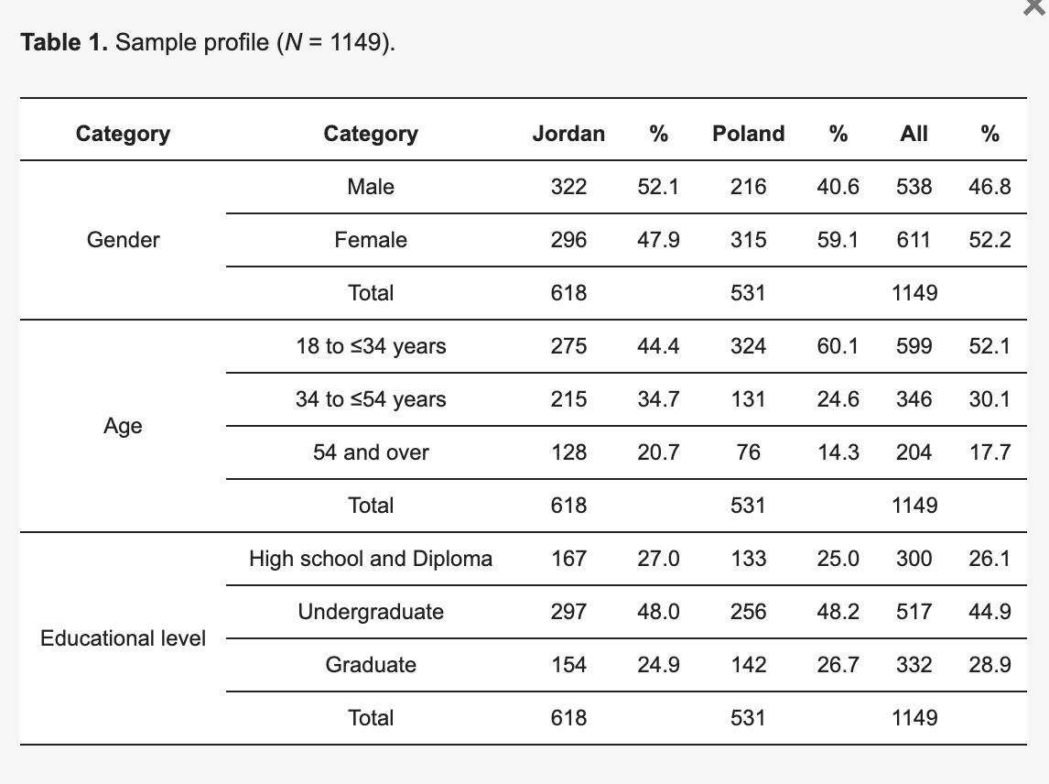
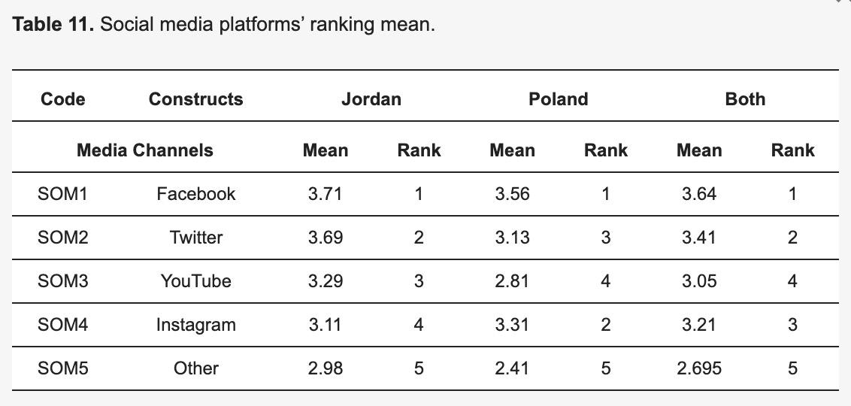
Preference for Social Media Platforms Among Demographics
Abuhashesh, M.Y.; Al-Dmour, H.; Masa’deh, R.; Salman, A.; Al-Dmour, R.; Boguszewicz-Kreft, M.; AlAmaireh, Q.N. The Role of Social Media in Raising Public Health Awareness during the Pandemic COVID-19: An International Comparative Study. Informatics 2021, 8, 80. https://doi.org/10.3390/informatics8040080
Notes:
We did some research on what social media platforms – here is the demographic of our sample – and it seems that Facebook and Twitter tend to be especially effective in promoting information
“Which social media platforms are the most preferred among xxx population (define below)”
https://www.mdpi.com/2227-9709/8/4/80
Investigate the role of social media campaigns (the type of social media platform, type of message, and message source sender) in raising public health awareness and behavioral change during (COVID-19) as a global pandemic across national selected countries (Poland and Jordan)
​​A total of 1149 web questionnaires were collected from respondents in the two countries (Poland 531 and Jordan 618)
Positive relationships between the components of a social media campaign, public health awareness, and behavioral change during (COVID-19) in the two countries at the same time
The preferred type of social media platforms, the message types and type of source sender significantly differ among the respondents due to their countries.
Note: Covid is an infectious disease – Sepsis is not, but sepsis is often caused by infection

Slide 18
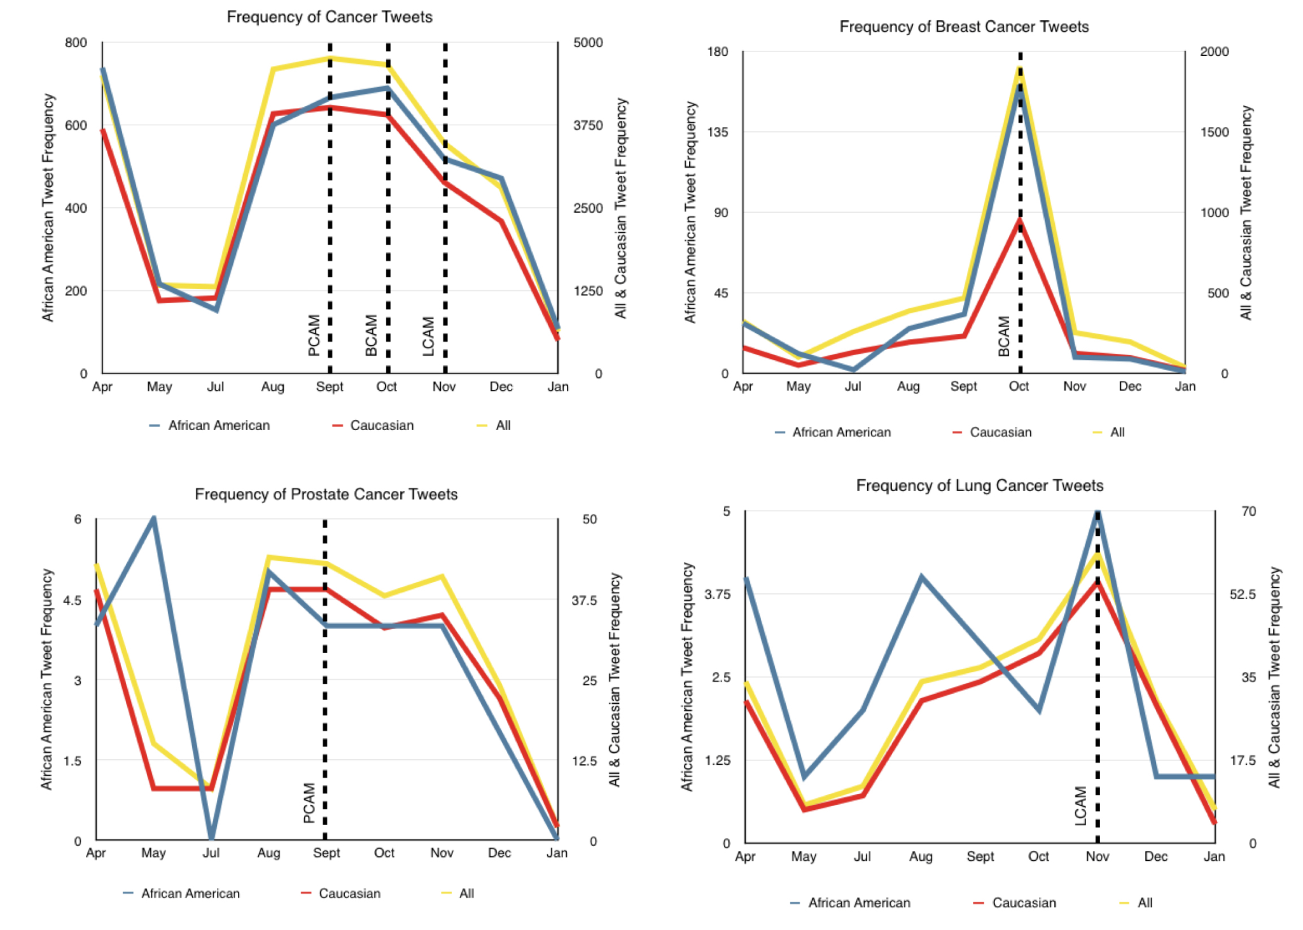
Frequency of Cancer Discussions Among Twitter Users by Race
Xu S, Markson C, Costello K, Xing C, Demissie K, Llanos A
Leveraging Social Media to Promote Public Health Knowledge: Example of Cancer Awareness via Twitter
JMIR Public Health Surveill 2016;2(1):e17
URL: https://publichealth.jmir.org/2016/1/e17
DOI: 10.2196/publichealth.5205
Notes:
We looked at cancer discussions and awareness among twitter users by race, and it seems that the platform does less well in reaching African American women about lung cancer, as opposed to white and South Asian women, which are the demographics most active in breast cancer discussions.
These kinds of investigations are helpful because we notice that sepsis is especially not well prevented among people of certain demographic, for example Pakistani people. We wouldn’t want the platform/algorithm we choose to somehow discriminate against educating particular demographics about sepsis.
“Examine the frequency of discussion and differences by race and ethnicity of cancer-related topics among unique users via Twitter”
https://publichealth.jmir.org/2016/1/e17/
Observable usage patterns of the terms "cancer", "breast cancer", "prostate cancer", and "lung cancer" between Caucasian and African American groups were evident across the study period. We observed some variation in the frequency of term usage during months known to be labeled as cancer awareness months, particularly September, October, and November. Interestingly, we found that of the terms studied, "colorectal cancer" received the least Twitter attention.
It is widely known that cancer of the lung is the leading cause of cancer death in the United States among both men and women and that tobacco smoking is the most significant and preventable cause of the disease. However, findings from one study [11] suggested that two-thirds of US women could not correctly identify lung cancer as the leading cause of cancer death, and this lack of knowledge was greatest among African American women [11]. In terms of breast cancer, evidence has shown that breast cancer knowledge also greatly varies by racial and ethnic group. One study [13] showed that African American women were generally unaware of disparities in breast cancer mortality. Furthermore, one study found that South Asian women tend to have better knowledge of age-related breast cancer risks when compared with black and white women [14]. Knowledge and awareness about both prostate and colorectal cancers have been shown to be low among US adults overall and particularly among low SES groups [12,15-17]. These examples highlight the importance of promoting knowledge about cancer among some segments of the US population, particularly among groups with the highest cancer burden.
TAKEAWAY & connect to our app

Slide 19
Future Areas of Development & Research
Support Different Languages - with the help of Generative AI!
Raising Awareness through Social Media
Celebrities who have experienced sepsis can reach many people by making posts
Traditional Communications - Posters, Talks

Slide 20
Famous people affected by Sepsis
Ashley Park, actress – treated for tonsillitis that progressed to sepsis
Paul Allen, Co-Founder of Microsoft – died
Jon Huntsman, philanthropist – died
Rusty Staub, baseball player – died
Larry King, TV personality – died
Pranab Mukherjee, former president of India – died
Mother Theresa, infected pacemaker line, survived but died years later of other causes
Harry Houdini, magician – died
Prince Ranier of Monaco, “chest infection” – died
George H.W. Bush, former President of the United States
Source: https://www.sepsis.org/sepsisand/celebrities/

Slide 21
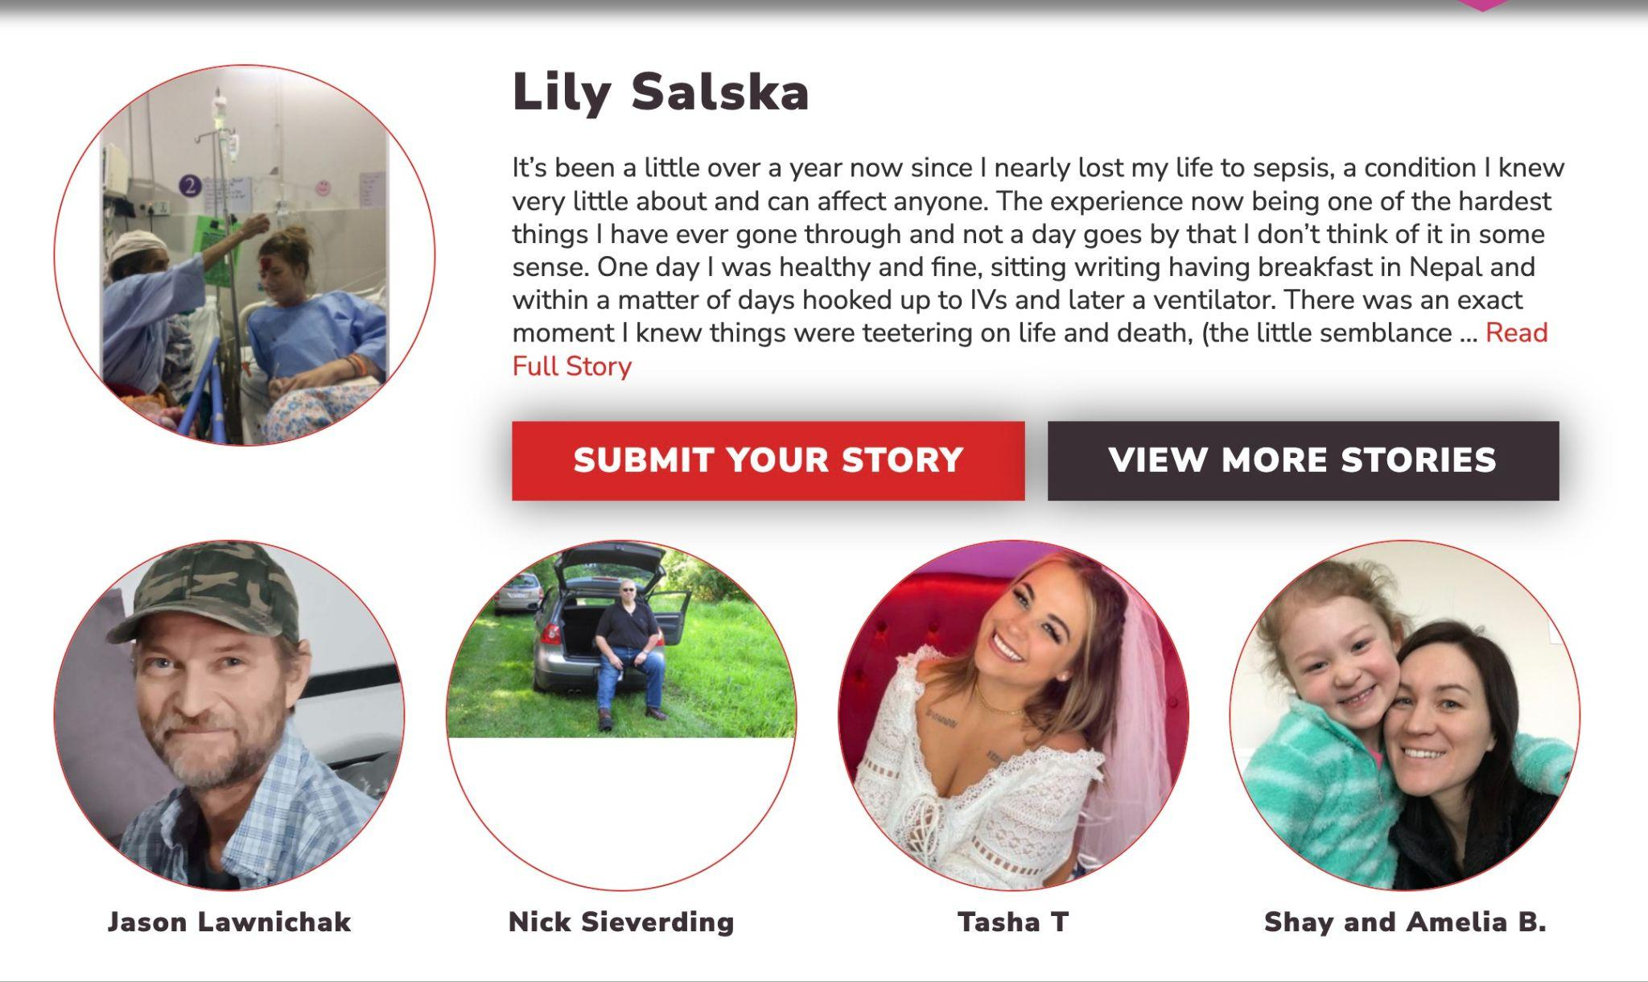
Raising Awareness - Celebrities
Source: https://www.sepsis.org/sepsisand/celebrities/

Slide 22
Future Areas of Development & Research
Support Different Languages - with the help of Generative AI!
Raising Awareness through Social Media
Collaborate with celebrities who have experienced sepsis
Traditional Communications - Posters, Talks

Slide 23
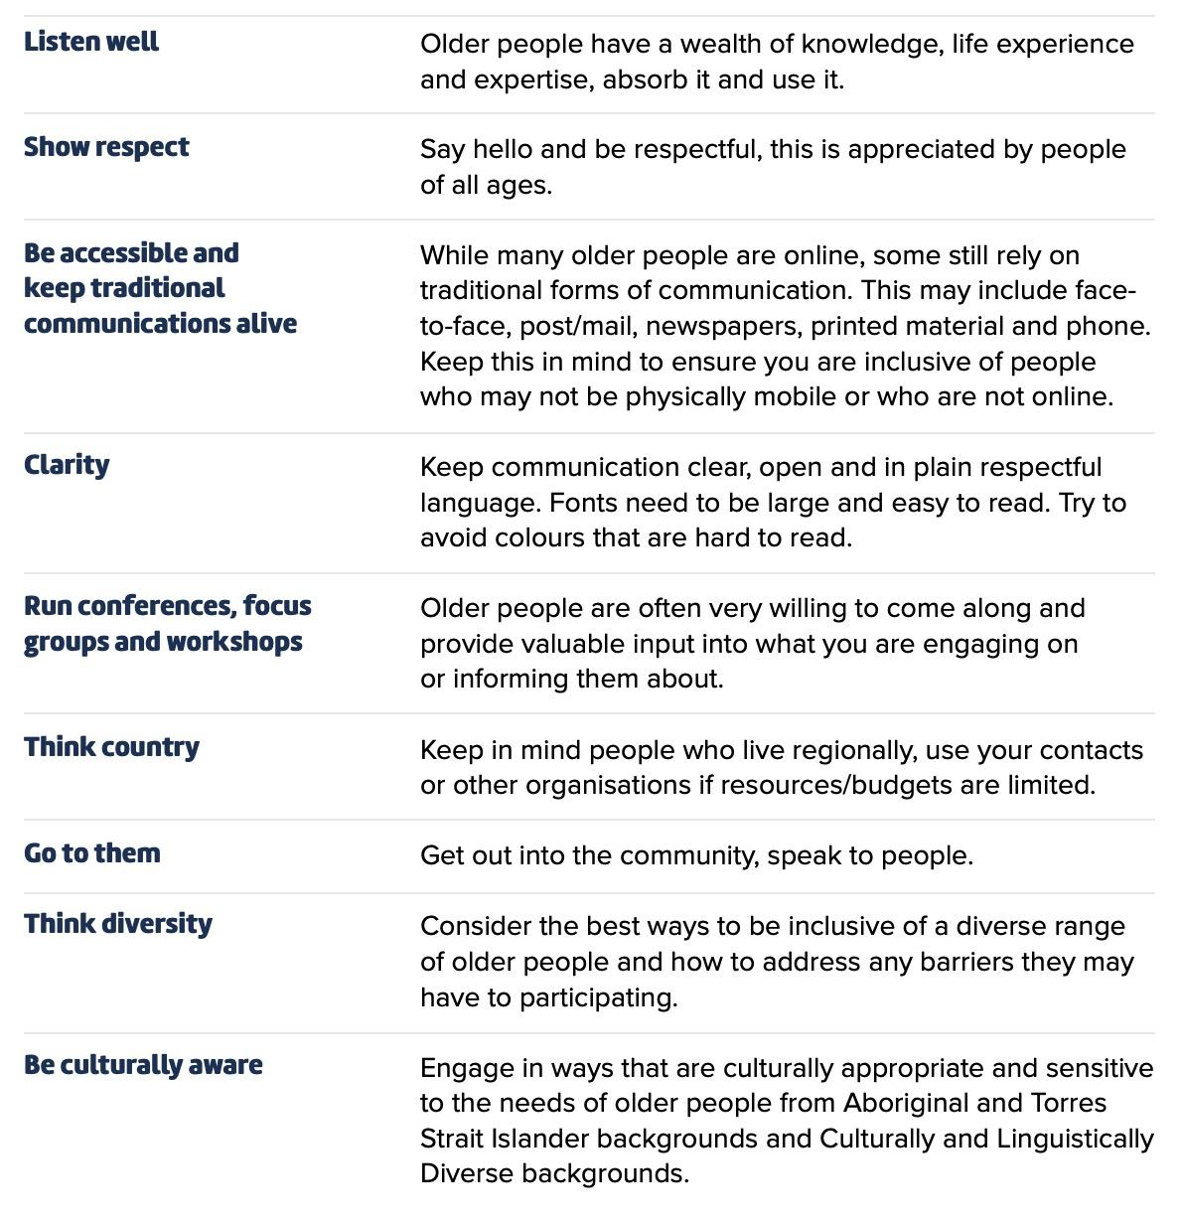
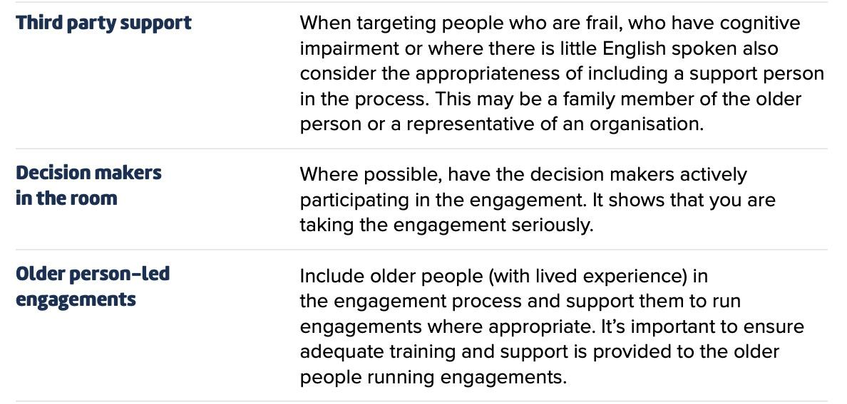
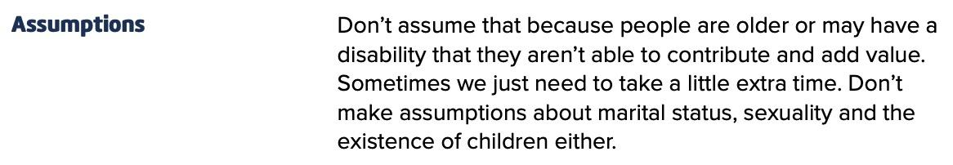
Connecting with the Older Demographic
Source: Australian government, https://www.sahealth.sa.gov.au/wps/wcm/connect/efc56a004efc69f1b7ccf79ea2e2f365/Better+Together+-+A+Practical+Guide+to+Effective+Engagement+with+Older+People.pdf?MOD=AJPERES&amp;CACHEID=ROOTWORKSPACE-efc56a004efc69f1b7ccf79ea2e2f365-nwLmRMW

Slide 24
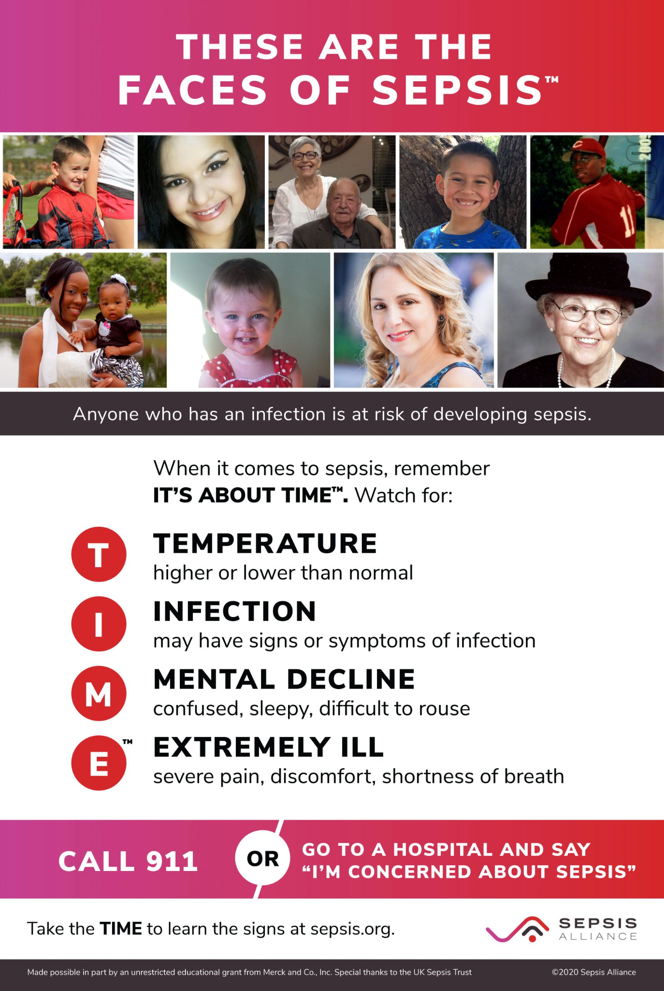


Traditional Communications

Slide 25
Questions?

